Slide 1

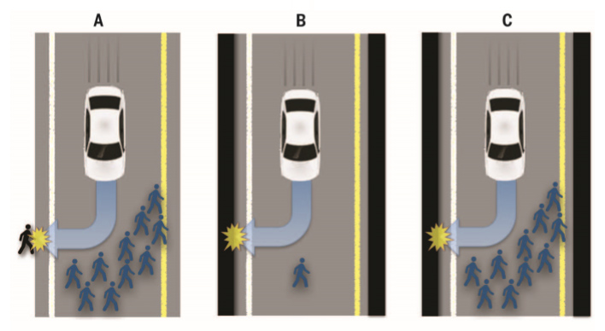
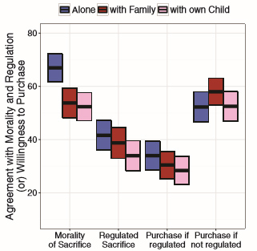
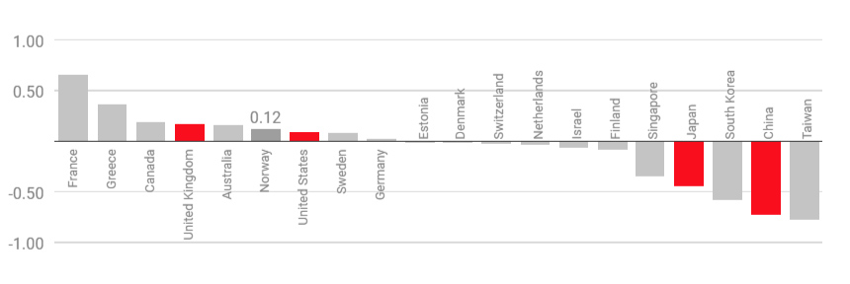

Personal ethics settings in autonomous vehicles
Nathan Koch <ndkoch@andrew.cmu.edu>, Jacob Brezina<jbrezina@andrew.cmu.edu>
Introduction
The increasing popularity of autonomous vehicles has brought attention to several ethical dilemmas regarding safety and accountability. One of the most difficult is autonomous behavior in crisis situations, and who if anyone should be allowed to set the preferred behavior.
Findings
In a survey of 182 participants 76% of people would prefer the AV to minimize the number of injuries over the safety of the driver.
In a survey of 393 participants, individuals were almost three times as likely to purchase a vehicle with customizable ethics settings, as opposed to one with government regulated settings.
Conclusion
Conclusion
Enforcement of mandatory ethics settings in autonomous vehicles will reduce popularity, and therefore slow advances in the field, especially in safety-related technology.
Personal ethics settings allow for individuals to better represent both their values and their culture’s values in their decision making.
Possible AV crises, where the AV must decide between killing a crowd or one pedestrian (A) one pedestrian or the driver (B) a crowd or the driver (C)
Objectives
We argue that personal ethics settings should be allowed for autonomous vehicles without government or corporate interference.
Values closer to 1 represent a countries preference for sparing the young in a crisis situation, values closer to -1 represent sparing the old
Works Cited
(1) Bonnefon, J., Shariff, A., & Rahwan, I. (2016). The social dilemma of autonomous vehicles
(2) Etzioni, A, & Etzioni, O (2016). AI assisted ethics. Ethics and Information Technology
(3) Gogoll, J, & Müller, J. F (2016). Autonomous Cars: In Favor of a Mandatory Ethics Setting
(4) Nyholm, S., & Smids, J. (2016). The Ethics of Accident-Algorithms for Self-Driving Cars: An
Applied Trolley Problem?

